Slide 1
Churn Analysis

Slide 2
Table of contents
01
05
02
06
03
07
04
08
Introduction
Tenure Category and the churn rate
Problem and Approach
AVERAGE TRANSACTION AMOUT BY AGE CATERGORY AND GENDER
Overall Churn Percentage
TENURE CATEGORY AND AVERAGE PURCHASE
Top Customers and their churn status
TENURE CATEGORY AND SATISFACTION SCORE

Slide 3
Table of contents
09
10
Churn Rates Across Customer Recency Segments
Key Findings

Slide 4
Overview
Churn analysis is the process of studying why customers stop using a product or service. It's also known as customer attrition analysis.

Slide 5
Problem
Approach
Customer churn is a significant challenge for Company, impacting revenue and growth. This analysis aims to identify the key drivers of churn within the company and develop insights to identify at-risk customers. The goal is to implement targeted retention strategies based on these insights, ultimately reducing churn . Understanding and mitigating churn is crucial for sustainable business success.
Analyze customer data using SQL queries to uncover insights into churn rate and its contributing factors, visualizing the findings to identify key trends and inform retention strategies.

Slide 6

REQUEST 1:
FIND THE OVERALL CHURN PERCENTAGE
52.6% of customers or have discontinued their service with the company . A 52.6% churn rate is generally considered quite high. It indicates a significant loss of customers.

Slide 7
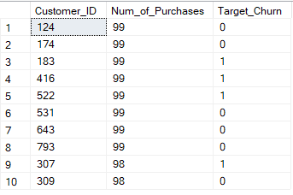
REQUEST 2
Determine the top 10 customers with the highest number of purchases and assess their churn status.

Slide 8
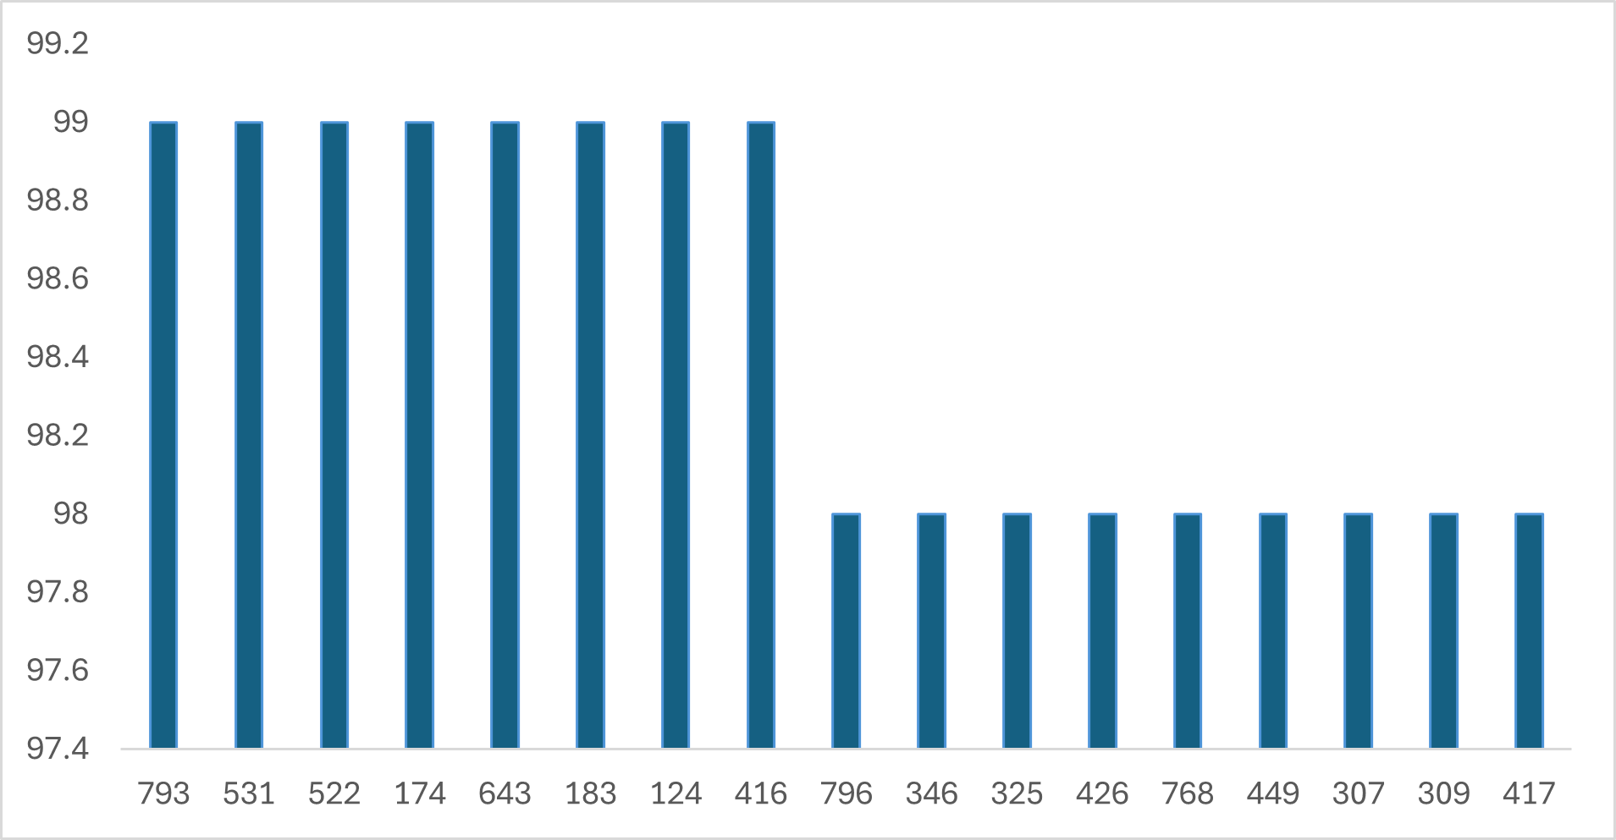
This column chart visualizes the number of purchases made by the top 10 customers. Only 4 of the top 10 customers retained their service, which is a very alarming churn rate.

Slide 9
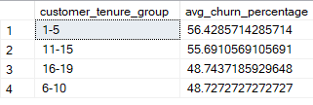
REQUEST 3
Determine the distribution of customer tenure (in years) and the corresponding churn rates for each tenure category.

Slide 10
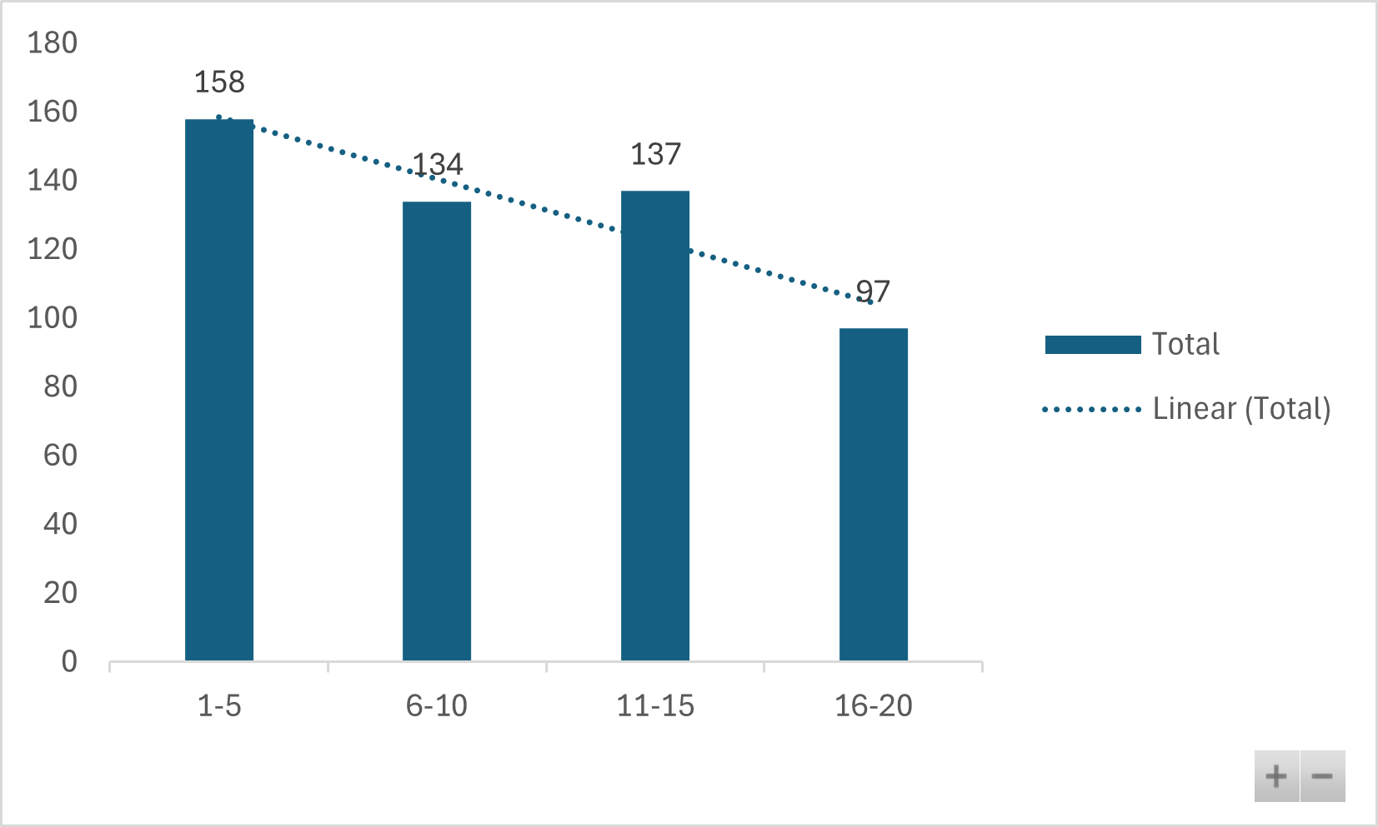
There is a general downward trend in the values from the first category (1-5) to the last category (16-20). This suggests that churn rate is decreasing as the category number increases.
The first category (1-5) has the highest value (158), indicating it has the largest churn rate(56%) among the categories.
The middle two categories (6-10 and 11-15) have relatively similar values (134 and 137)(48% and 55% respectively). While there is a slight decrease followed by an increase, the changes are not drastic.
There is a notable drop in value (97) in the last category (16-20). This suggests a substantial decrease or reduction in the churn rate.
The X-axis represents customer tenure (years).
The Y-axis displays the churn rate for each tenure category.

Slide 11
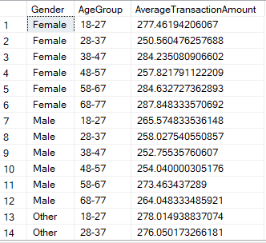
REQUEST 4
GET THE AVERAGE TRANSACTION AMOUT BY AGE CATERGORY AND GENDER

Slide 12
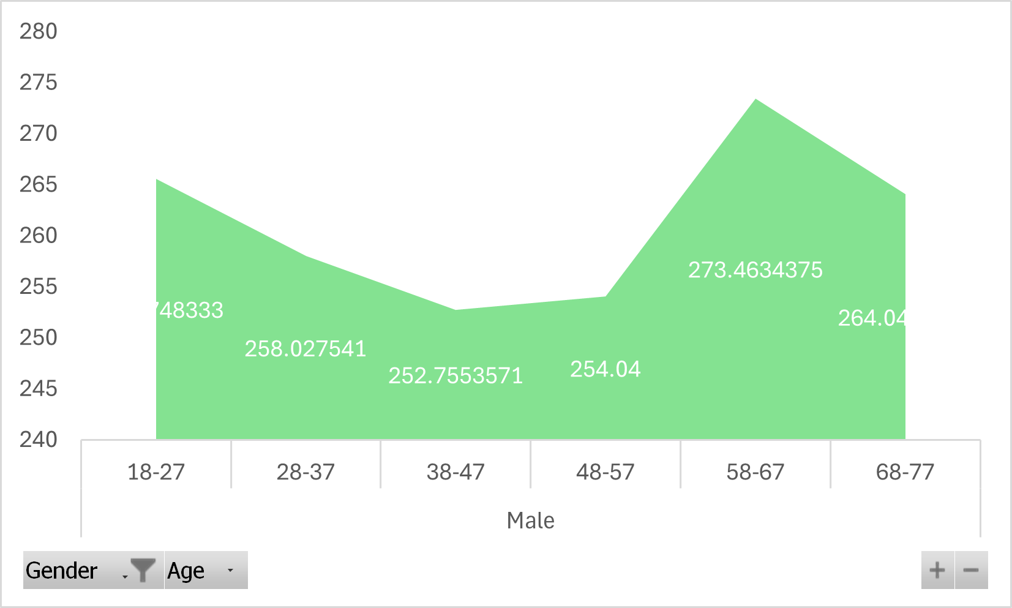
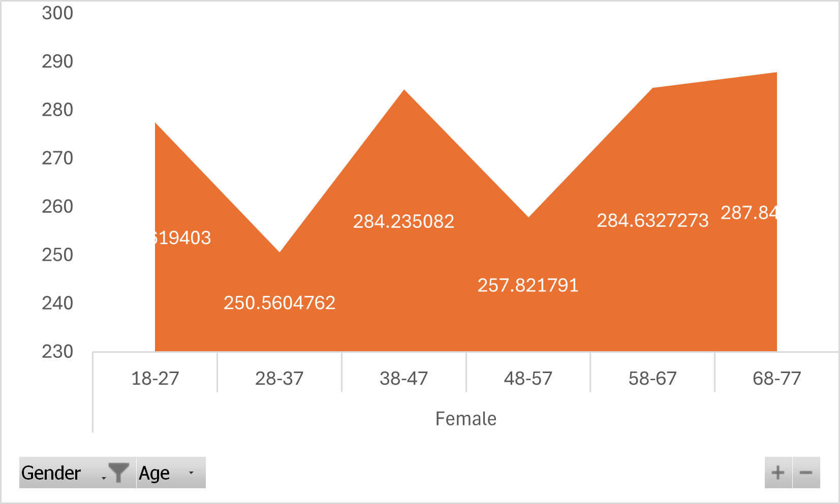
The chart depicts the average transaction amount for males across different age groups. There's a noticeable fluctuation and an overall upward trend as age increases.
The chart depicts the average transaction amount for males across different age groups. There's a noticeable fluctuation and an overall upward trend as age increases.
Males
The chart depicts the average transaction amount for males across different age groups. There's a noticeable fluctuation and an overall upward trend as age increases.
Age Group 58-67 has the highest average transaction amount among other age categories.
Females
Average transaction amounts fluctuate across age groups, with the highest spending occurring in the 58-67 age range (reaching approximately 287.84) and the lowest in the 28-37 range (around 250.56). Spending generally increases from the late 20s through the pre-retirement years, peaking as women approach retirement age, before slightly decreasing in the oldest age group.

Slide 13
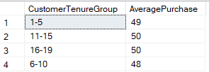
The chart depicts the average transaction amount for males across different age groups. There's a noticeable fluctuation and an overall upward trend as age increases.
The chart depicts the average transaction amount for males across different age groups. There's a noticeable fluctuation and an overall upward trend as age increases.
REQUEST 5
DETERMINE THE CUSTOMER TENURE CATEGORY AND THE AVERAGE PURCHASES OF EACH TENURE CATEGORY

Slide 14
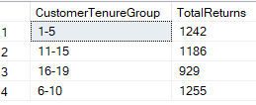
The chart depicts the average transaction amount for males across different age groups. There's a noticeable fluctuation and an overall upward trend as age increases.
The chart depicts the average transaction amount for males across different age groups. There's a noticeable fluctuation and an overall upward trend as age increases.
REQUEST 6
DETERMINE THE CUSTOMER TENURE CATEGORY AND THE AVERAGE PURCHASES OF EACH TENURE CATEGORY.
Customer returns are highest for mid-tenure customers, particularly those with 6-10 years of tenure (1255 returns),
followed closely by newer customers with 1-5 years of tenure (1242 returns) . Long-term customers (16-19 years) have the lowest return rate (929), suggesting increasing satisfaction or different purchasing behaviors over time. These trends point to potential issues affecting mid-tenure and newer customers that warrant further investigation.

Slide 15
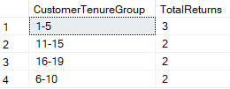
REQUEST 7
DETERMINE THE CUSTOMER TENURE CAEGORY AND THE AVERAGE SATISFACTION SCORE OF EACH CUSTOMER TENURE CATEGORY.

Slide 16
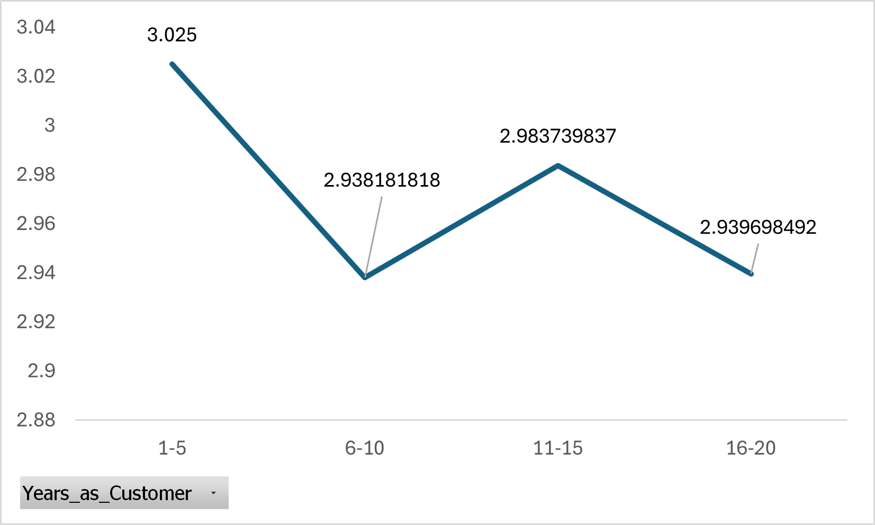
Customers with 1-5 years of tenure have the highest average satisfaction score, indicating a strong initial positive experience. Satisfaction dips notably for the 6-10 year group and then fluctuates in the subsequent groups, suggesting potential areas for improvement in long-term customer engagement and retention strategies. The overall trend appears to be a decline in satisfaction as customer tenure increases beyond the initial period.

Slide 17

REQUEST 8
DETERMINE THE CHURN RATE FOR EACH CUSTOMER SEGMENT BASED ON RECENCY OF PURCHASE.
*INACTIVE – LAST PURCHASED 90 DAYS AGO,*LAPSED – LAST PURCHASED BETWEEN 31 AND 90 DAYS , RECENT – LAST PURCHASED 30 DAYS AGO

Slide 18
Churn Rates Across Customer Recency Segments
Customer churn is alarmingly high across all recency segments, with over 50% of customers in each group churning.
Surprisingly, recent customers exhibit the highest churn rate at nearly 60%, suggesting potential issues with onboarding or initial customer experience.
Lapsed and inactive customers also show significant churn, indicating wider problems with customer retention beyond the initial phase.
These findings necessitate a thorough investigation into customer experience, data accuracy, and potential pain points to identify the root causes of churn.
Addressing the high churn rate, especially among new customers, should be a key priority for the business.

Slide 19






KEY FINDINGS
A 52.6% churn rate is very high and indicates a serious problem for most businesses.
Only 4 of the Top 10 customers retained their service with the company.
Customers with 1-5 years of tenure have the highest churn rate, while those with 11-15 and 16-20 years have similar, lower churn rates.
The 58-67 age group exhibits the highest transaction rate for both male and female customers.
The highest customer return rates are seen among mid-tenure and new customers.
Customers with 1-5 years of tenure report the highest average satisfaction, suggesting a positive initial experience. Satisfaction then declines for the 6-10 year group and fluctuates thereafter.

